Slide 1
R2Sonic challenge
2019/11/14

Slide 2
Multi-freq. decomposition
All XTF files from 4 runs (run A, B, C, D) contain same characteristics
i.e.
- on 3 frequencies (170, 330, 450): clearly see the bottom, and very vaguely the sediment
- on 700 KHz: clearly see suspended sediments

Slide 3
170 KHz – 120º swath
330 KHz – 120º swath
450 KHz – 120º swath
700 KHz – 70º swath

Slide 4
Documentation [Topping and Wright, 2016]
Physically-based method for simultaneously measurement of
suspended silt and clay concentration
suspended sand concentration
suspended sand grain size
Using multi-frequency arrays of single-frequency side-looking acoustic Doppler profilers (ADPs)
Operational frequency:
600 kHz (less used)
1 MHz
2 MHz
Acquired data at one location of 12 years, with 15-minute interval
Our WC data: only on 2019/02/26 between 8:46 and 9:04 PM ()
I.E. only 2 ground truth samples (8:45 and 9:00 PM), at one location
However, historical data can be interesting

Slide 5
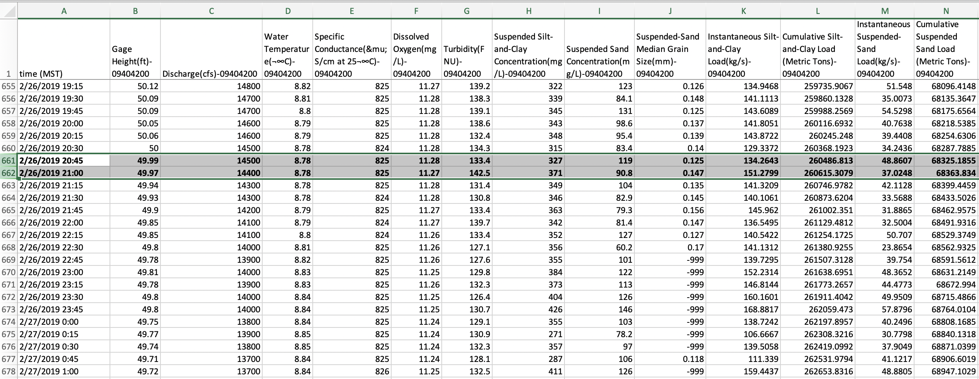

Slide 6
5 types of errors [Topping and Wright, 2016]
Stability of acoustical calibration over time
Effect of neglecting backscatters from silt and clay
Bias arising from change in sand grain size
Time varying error
Influence of non-random processes (e.g. slow changes in spatial structure of suspended sediments)
“The error analyses indicate that the two-frequency method produces unbiased measurements of suspended-silt-and-clay and sand concentration, with errors that are similar to, or larger than, those associated with conventional sampling methods.”

Slide 7
[Simmons et al. 2010]
SSC: suspended sediment concentration
Used MBES RESON SeaBat 8125 455 KHz (single-frequency)
The study tried to confirm a correlation between SSC and nSv (normalized acoustic backscatter strength per unit volume of ensonified water)
Unable to determine grain size with one frequency
Relied on another direct measuring method of SSC, for the knowledge of grain size
Almost the same situation with our dataset: as only 700KHz data “see” the suspended sediments

Slide 8
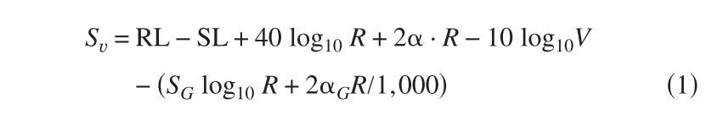
Sonar equation for determining nSv [Simmons et al. 2010]
RL: receive level
SL: source level
R: radial distance along the axis of each beam
alpha: sound attenuation
V: size of each sampling volume (computed based on sampling distance (=c*pulse_length/2), along- and across-track beam width)
S_G: spreading loss coefficient (TVG)
alpha_G: absorption coefficient (TVG)

Slide 9


Sv calculated from 450 KHz pings and 700 KHz pings

Slide 10
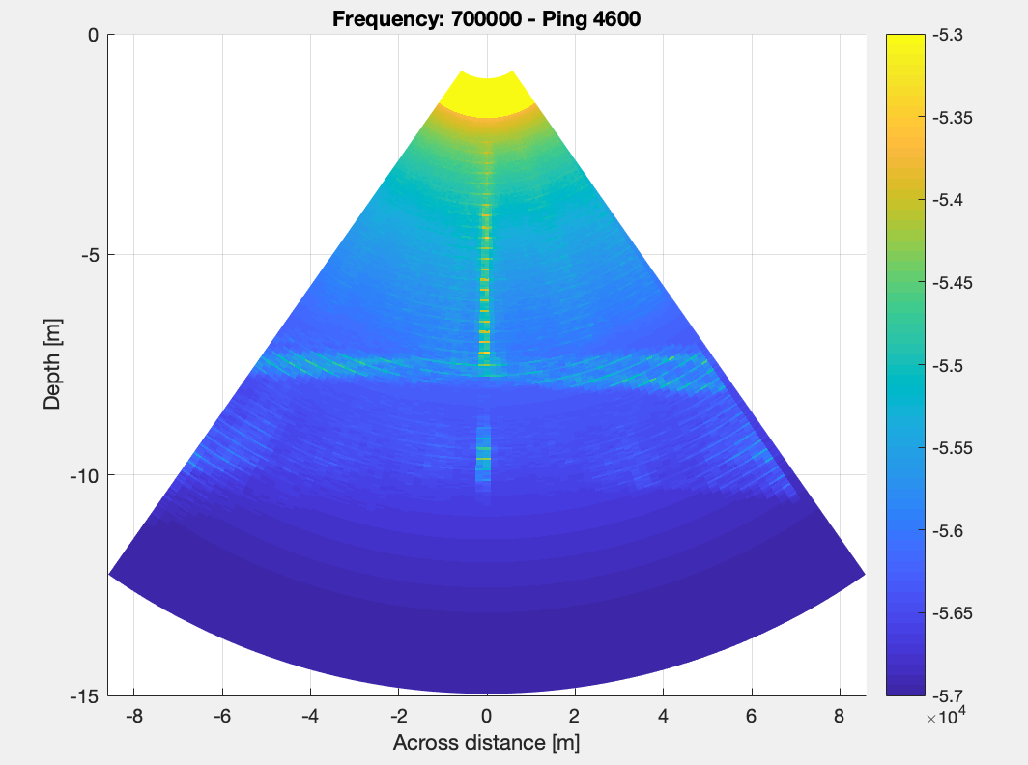
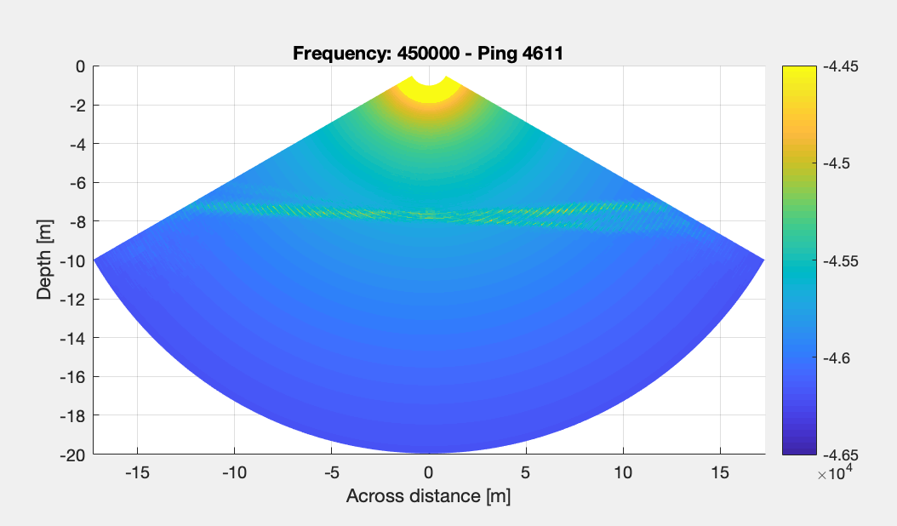
Combined-all-pings figure

Slide 11
Reference
[Topping and Wright, 2016] | Topping, D. J., & Wright, S. A. (2016). Long-Term Continuous Acoustical Suspended-Sediment Measurements in Rivers — Theory , Application , Bias , and Error. https://doi.org/10.3133/pp1823
[Simmons et al. 2010] | Simmons, S. M., Parsons, D. R., Best, J. L., Orfeo, O., Lane, S. N., Kostaschuk, R., … Pocwiardowski, P. (2010). Monitoring Suspended Sediment Dynamics Using MBES. Journal of Hydraulic Engineering, 136(1), 45–49. https://doi.org/10.1061/(ASCE)HY.1943-7900.0000110

